Slide 1

HOLY MARY INSTITUTE OF TECHNOLOGY & SCIENCE (Approved by AICTE, New Delhi, Affiliated to JNTU, Hyderabad)
BOGARAM(V),KEESARA(M),MEDCHAL DISTRICT-501301
2021-2022
DEPARTMENT OF COMPUTER SCIENCE ENGINEERING
PREDICTING COVID-19 PANDEMIC
USING MACHINE LEANING
By:
T.AKHIL(18C91A0599)
T.DIVYASRI(18C91A05A0)
V.PRAVALYA(18C91A05B1)
Under the guidance of:
Name:MR.RAVINDHER

Slide 2
ABSTRACT
In this project we will building a machine learning model using python to discuss the spread of corona virus as well as certain steps taken by governments of countries such as india,china,south korea,and Italy.The covid 19 is on the spread it basically goes through four stages.The outbreak of corona virus is obviously developing in to a major international crisis and lending to influence the most important aspects of our daily lifes.
The objective of this project is to come up with a strong machine learning module which predicts how the virus could spread across different countries in regions the goal of this is to come up with something that predicts the spread of the virus in the next week.
This model is written in Jupiter and its being executed using kolob.

Slide 3
.
EXISTING SYSTEM:
Our society is in the era of unbelievable attempts to struggle upon the spread of this life-threatening condition in terms of infrastructure, finance, business, manufacturing, and several other resources. Artificial Intelligence (AI) researchers strengthen their proficiency in developing mathematical paradigms for investigating this pandemic using nationwide distributed data.AI can in principle be used to track and to predict how the COVID-19 disease will spread over time and space. In fact, an AI-based model of HealthMap, at Boston Children’s Hospital (USA), sounded one of the first alarms on 30 December 2019, around 30 minutes earlier than a scientist at the Program for Monitoring Emerging Diseases (PMED) issued an alert (see the discussion in Naudé 2020). For the further tracking and prediction of how COVID-19 will spread, however, AI has so far not been very useful. This is for a number of reasons. This article intends to apply the machine learning models simultaneously with the forecast of expected reachability of the COVID-19 over the nations by using the real-time data from the Johns Hopkins dashboard

Slide 4
DISADVANTAGES OF EXISTING SYSTEM
NEEDS HUMAN SURVILLANCE
MAY OVERLOOK SOCIAL VARIABLES
MAY LEAD TO UNEMPLOYMENT
INACCURACIES ARE STILL POSSIBLE
SUSCEPTIBLE TO SECURITY RISKS

Slide 5
PROPOSED SYSTEM:
The proposed method is based on machine learning framework. Logistic Regression algorithm has been
used for predicting the COVID-19 in someone’s body.
data collection
processing data
Training the data
Applied linear
regression on Algorithm

Slide 6
Advantages :
1.Process of learning is simply learning from experience or observations.
2.The basic aim of ML is to make computers learn automatically with no human intervention.
3.ML techniques are used to interpret and analyze large datasets and predict their output.
Disadvantages:
1.Machine learning requires massive data sets to train on.
2.ML needs enough time to let the algorithms learn and develop enough to fufill their purpose with a considerable amount of accuracy and relevancy.
3.It also needs massive resources to function.

Slide 7
SOFTWARE REQUIREMENTS :
Operating system : Windows 10.
Coding Language : Python
Editor : JUPYTER
HARDWARE REQUIREMENTS :
System : Intel i 5Core.11thgen
Hard Disk : 80 GB.
Monitor : 15’’ LED
Input Devices : Keyboard, Mouse
Ram : 8GB

Slide 8
COVID- 19 DATASET
PREPROCESSING
ANALYSIS
DATA SPLITTING
OUTPUT:
CLASSIFYING COVID19 CONFIRMED CASES
TESTING
APPLYING ML ALGORITHMS

Slide 9
SYSTEM ANALYSIS
currently,ongoing efforts have been made to develop novel diagnostic approaches using machine learning algorithms. For example, machine learning-based Neural network classifiers were developed for large-scale screening of COVID-19 patients based on their distinct respiratory pattern . Similarly, a deep learning-based analysis system of thoracic CT images was constructed for automated detection and monitoring of COVID-19 patients over time . Rapid development of automated diagnostic systems based on artificial intelligence and machine learning not oCurrentlynly can contribute to increased diagnostic accuracy and speed but will also protect healthcare workers by decreasing their contacts with COVID-19 patients .

Slide 10
IMPLEMENTATION
import pandas as pd
from matplotlib import pyplot as plt
import seaborn as sns
import datetime as dt
import numpy as np
df=pd.read_csv('covid_19_india.csv',parse_dates=['Date'],dayfirst=True)
df.head()
df=df[['Date','State/UnionTerritory','Cured','Deaths','Confirmed’]]
df.columns=['date','state','cured','deaths','confirmed’]
df.head()
df.tail()
today=df[df.date=='2020-08-11’]
today
max_death_cases=today.sort_values(by="deaths",ascending=False)
max_death_cases
top_states_confirmed=max_confirmed_cases[0:5]
sns.set(rc={'figure.figsize':(15,10)})
sns.barplot(x="state",y="confirmed",data=top_states_confirmed,hue="state")
plt.show()
max_death_cases=today.sort_values(by="deaths",ascending=False)
max_death_cases
top_states_death=max_death_cases[0:5]
sns.set(rc={'figure.figsize':(15,10)})
sns.barplot(x="state",y="deaths",data=top_states_death,hue="state")
plt.show()
max_cured_cases=today.sort_values(by="cured",ascending=False)
max_cured_cases

Slide 11
top_states_cured=max_cured_cases[0:6]
sns.set(rc={'figure.figsize':(15,10)})
sns.barplot(x="state",y="cured",data=top_states_cured,hue="state")
plt.show()
tel=df[df.state=='Telengana’]
tel
sns.set(rc={'figure.figsize':(15,10)})
sns.lineplot(x="date",y="confirmed",data=tel,color="g")
plt.show()
sns.set(rc={'figure.figsize':(15,10)})
sns.lineplot(x="date",y="deaths",data=tel,color="r")
plt.show()

Slide 12
SYSTEM TESTING
Sno | Date | Time | State/UnionTerritory | ConfirmedIndianNational | ConfirmedForeignNational | Cured | Deaths | Confirmed
0 | 1 | 2020-01-30 | 6:00 PM | Kerala | 1 | 0 | 0 | 0 | 1
1 | 2 | 2020-01-31 | 6:00 PM | Kerala | 1 | 0 | 0 | 0 | 1
2 | 3 | 2020-02-01 | 6:00 PM | Kerala | 2 | 0 | 0 | 0 | 2
3 | 4 | 2020-02-02 | 6:00 PM | Kerala | 3 | 0 | 0 | 0 | 3
4 | 5 | 2020-02-03 | 6:00 PM | Kerala | 3 | 0 | 0 | 0 | 3

Slide 13
System testing
date | state | cured | deaths | confirmed
18105 | 2021-08-11 | Telangana | 638410 | 3831 | 650353
18106 | 2021-08-11 | Tripura | 77811 | 773 | 80660
18107 | 2021-08-11 | Uttarakhand | 334650 | 7368 | 342462
18108 | 2021-08-11 | Uttar Pradesh | 1685492 | 22775 | 1708812
18109 | 2021-08-11 | West Bengal | 1506532 | 18252 | 1534999

Slide 14
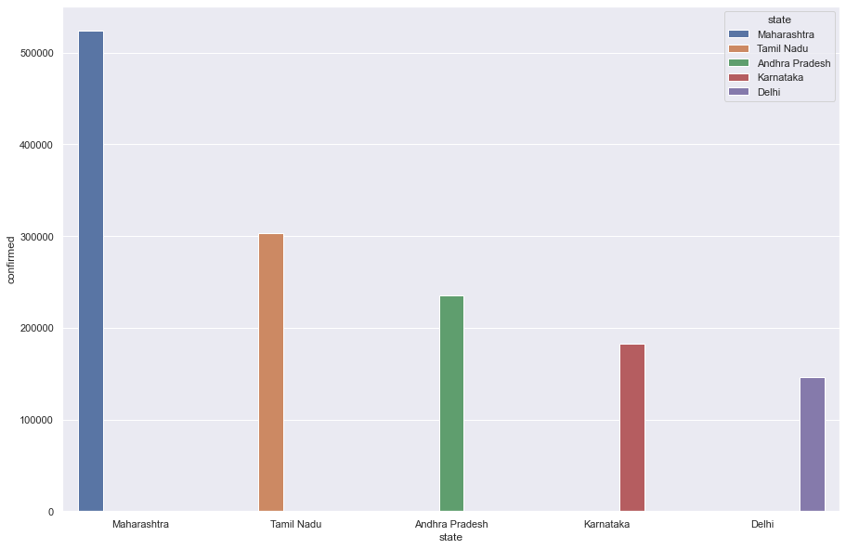
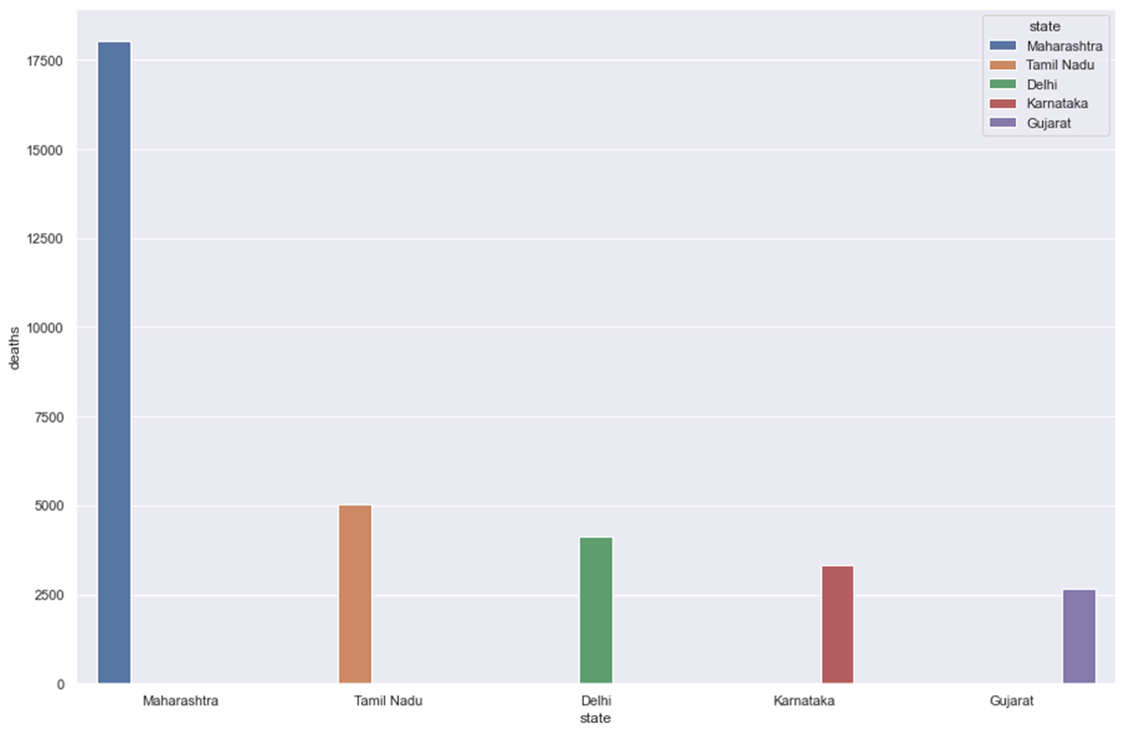
system testing

Slide 15
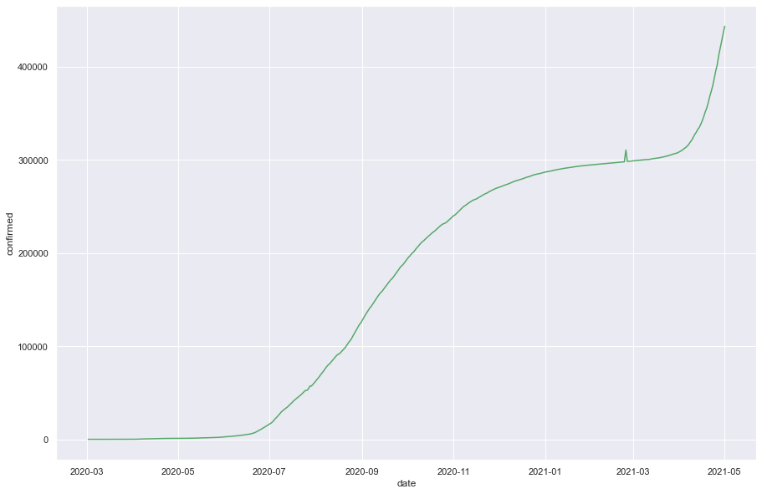
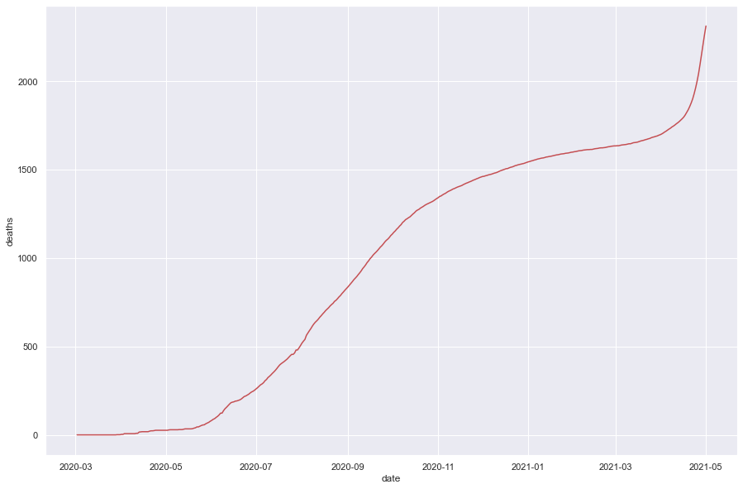
System testing

Slide 16
CONCLUSION
A ML-based prediction model can be used as a screening tool to identify patients at risk of imminent ICU transfer within 24 h. This tool could improve the management of hospital resources and patient-throughput planning, thus delivering more effective care to patients hospitalized with COVID-19.

Slide 17


